Slide 1
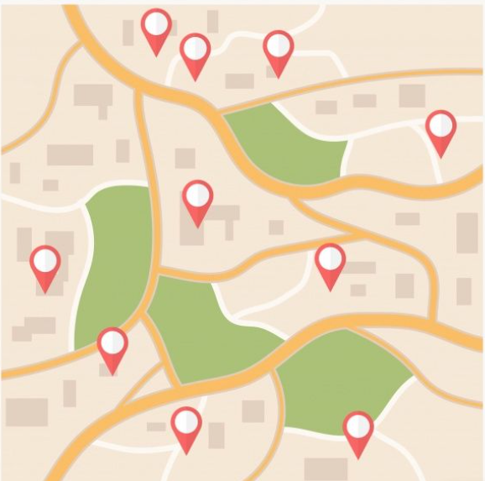
NavigateX
“Crafting your ideal path!”
By
Sign_IN

Slide 2

The
Motivation
The motivation behind this project is to create a user-friendly, efficient, and interactive route planning tool that helps individuals find the optimal routes between different locations. This application aims to simplify navigation, reduce travel time, and enhance overall convenience for users by leveraging modern mapping technologies. The problem we had whenever we need to find a place in this big Daffodil International University campus will be solved using “NavigateX”.

Slide 3
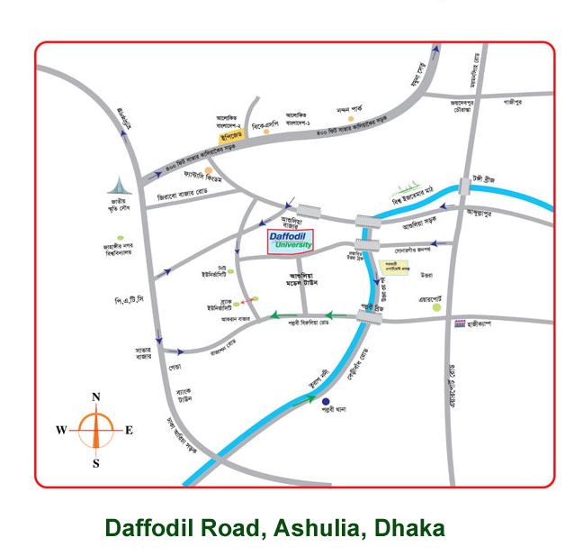
Objectives
To Get Effective Routing.
To Get Interactive User Interface.
To Get Alternative Routes.
To See Map Visualization.
To Get Offline Access.

Slide 4
Methodology
Graph Data Structure
Hash Map
Priority Queue
Array or List

Slide 5
Outcomes
Will get fully functional route planner application that provides efficient and accurate navigation solutions.
Will improved user experience and convenience for individuals needing route planning services.
Will get the location of everything including Hall , Building , Room , Teacher room , library , playground etc in accurate way . so you don’t have to get irritate while finding these.
Will be a valuable project for learning and demonstrating expertise in mapping technologies.

Slide 6
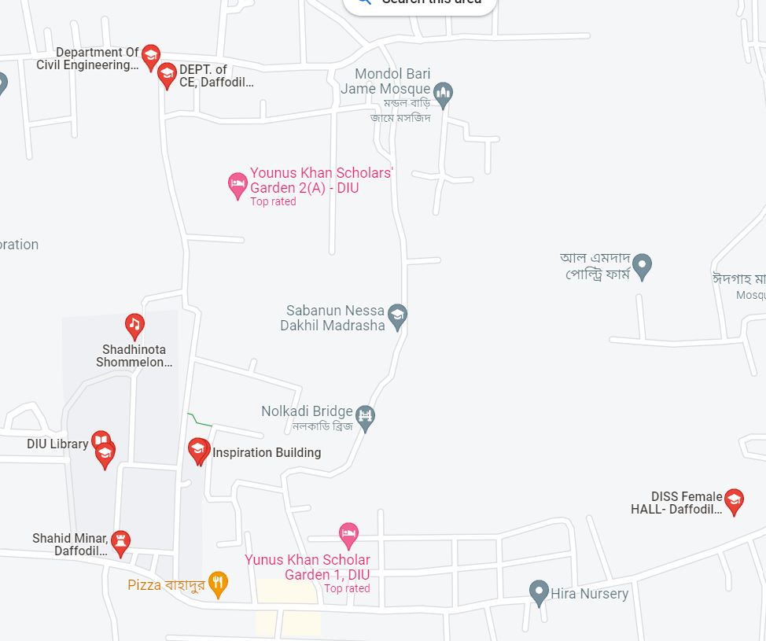
THANK YOU
Team
Sign_IN
1028, 1195, 1027, 1123, 1849, 1142

